Slide 1
SPEED. INNOVATION. SOLUTIONS.

Slide 2
UNDER A TITLE 15 PARTNERSHIP
Intermediary Agreement (PIA):
“BIG TENT” PHILOSOPHY
USSOCOM
Industry Partners
Academics & Interns
Interagency Partners
FFRDC’s & Labs
Non-Traditionals

Slide 3
CHARTER
A PLATFORM DESIGNED AND OPERATED TO HELP SOLVE CHALLENGING WARFIGHTER PROBLEMS THROUGH INCREASED COLLABORATION, EXPLORATION AND AGILE PROCESSES.​
Proof of theory. Proof of concept. Rapid prototyping.
I. Create and maintain a platform to accelerate delivery of innovative capabilities to USSOCOM​.
II. Facilitate capability refinement through exploration, experimentation and assessment of promising technology​.

Slide 4
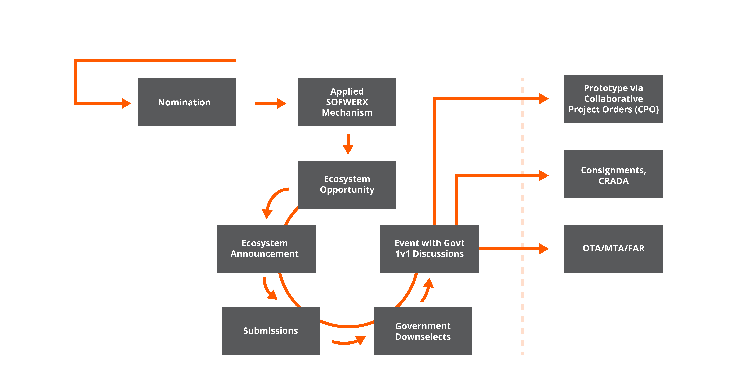
Challenges Provided by:
Total CPOs: 82
Components (731)
TSOCs and SOF Units (86)
HQ/j-Staff (180)

Slide 5
ENGAGEMENT
129
84
Collaboration Events
Assessment Events
SINCE 2015, SOFWERX HAS CONDUCTED 343 EVENTS TO ASSESS, VALIDATE, PROTOTYPE AND DEMONSTRATE NEW AND NOVEL TECHNOLOGIES​.
25
105
Prize
Challenges
Other

Slide 6
997 GOVERNMENT PERSONNEL IN ECOSYSTEM
IN MAY 2020, SOFWERX LAUNCHED TECH TUESDAY, A FORUM FOR INNOVATORS TO PRESENT TRANSFORMATIONAL TECHNOLOGIES TO USSOCOM AND OTHER GOVERNMENT PARTNERS.​
1442 TECHNOLOGIES SUBMITTED
750 TECHNOLOGIES PRESENTED TO USERS AND TECH STAKEHOLDERS​

Slide 7
IMPACT
Since 2015, SOFWERX has facilitated 452 projects and contracted $219.1M through 1078 purchase Orders and Business-to-Business (B2B) Agreements ​to advance technologies to the Warfighter.​​
66
TRANSITIONS
341
VALIDATIONS​
When USSOCOM awards a new contractual vehicle to provide a new, improved, or continuing material, weapon, information system or service capability in response to an approved need or Transitions to a Program of Record (PoR)​.
Validation of ideas and concepts as well as defining the coalition of the willing, the acquisition strategy and implementation plan​
131
CONSIGNMENTS​
838
KNOWLEDGE TRANSFERS​
Successful projects that are adopted, however the end item cost does not warrant moving to a program of record and the stakeholders purchase locally​.
Any new, novel or provocative idea, technique or technology we are able to share with USSOCOM​.

Slide 8
ADVANCED
MANUFACTURING
CAPABILITIES​
PERSONNEL
Foundry Manager/Mechanical Engineer
Fabrication Specialist
Interns
SOFTWARE​
SolidWorks - CAD​
Fusion 360 - CAM ​
Ansys Fluent - computational fluid dynamics & simulations​
MATLAB - mathematical computations
EQUIPMENT
Computer Numerical Control (CNC) - mill, lathe, plasma & laser cutters​
Manual - mill, lathe, hydraulic press brake, hydraulic ironworker, sheet roller, sewing machines​
Welding - all facets, including but not limited to MIG, TIG, Stick, steel/aluminum​
3D Printing - resin based, plastic filament based, plastic filament with carbon fiber inlay

Slide 9
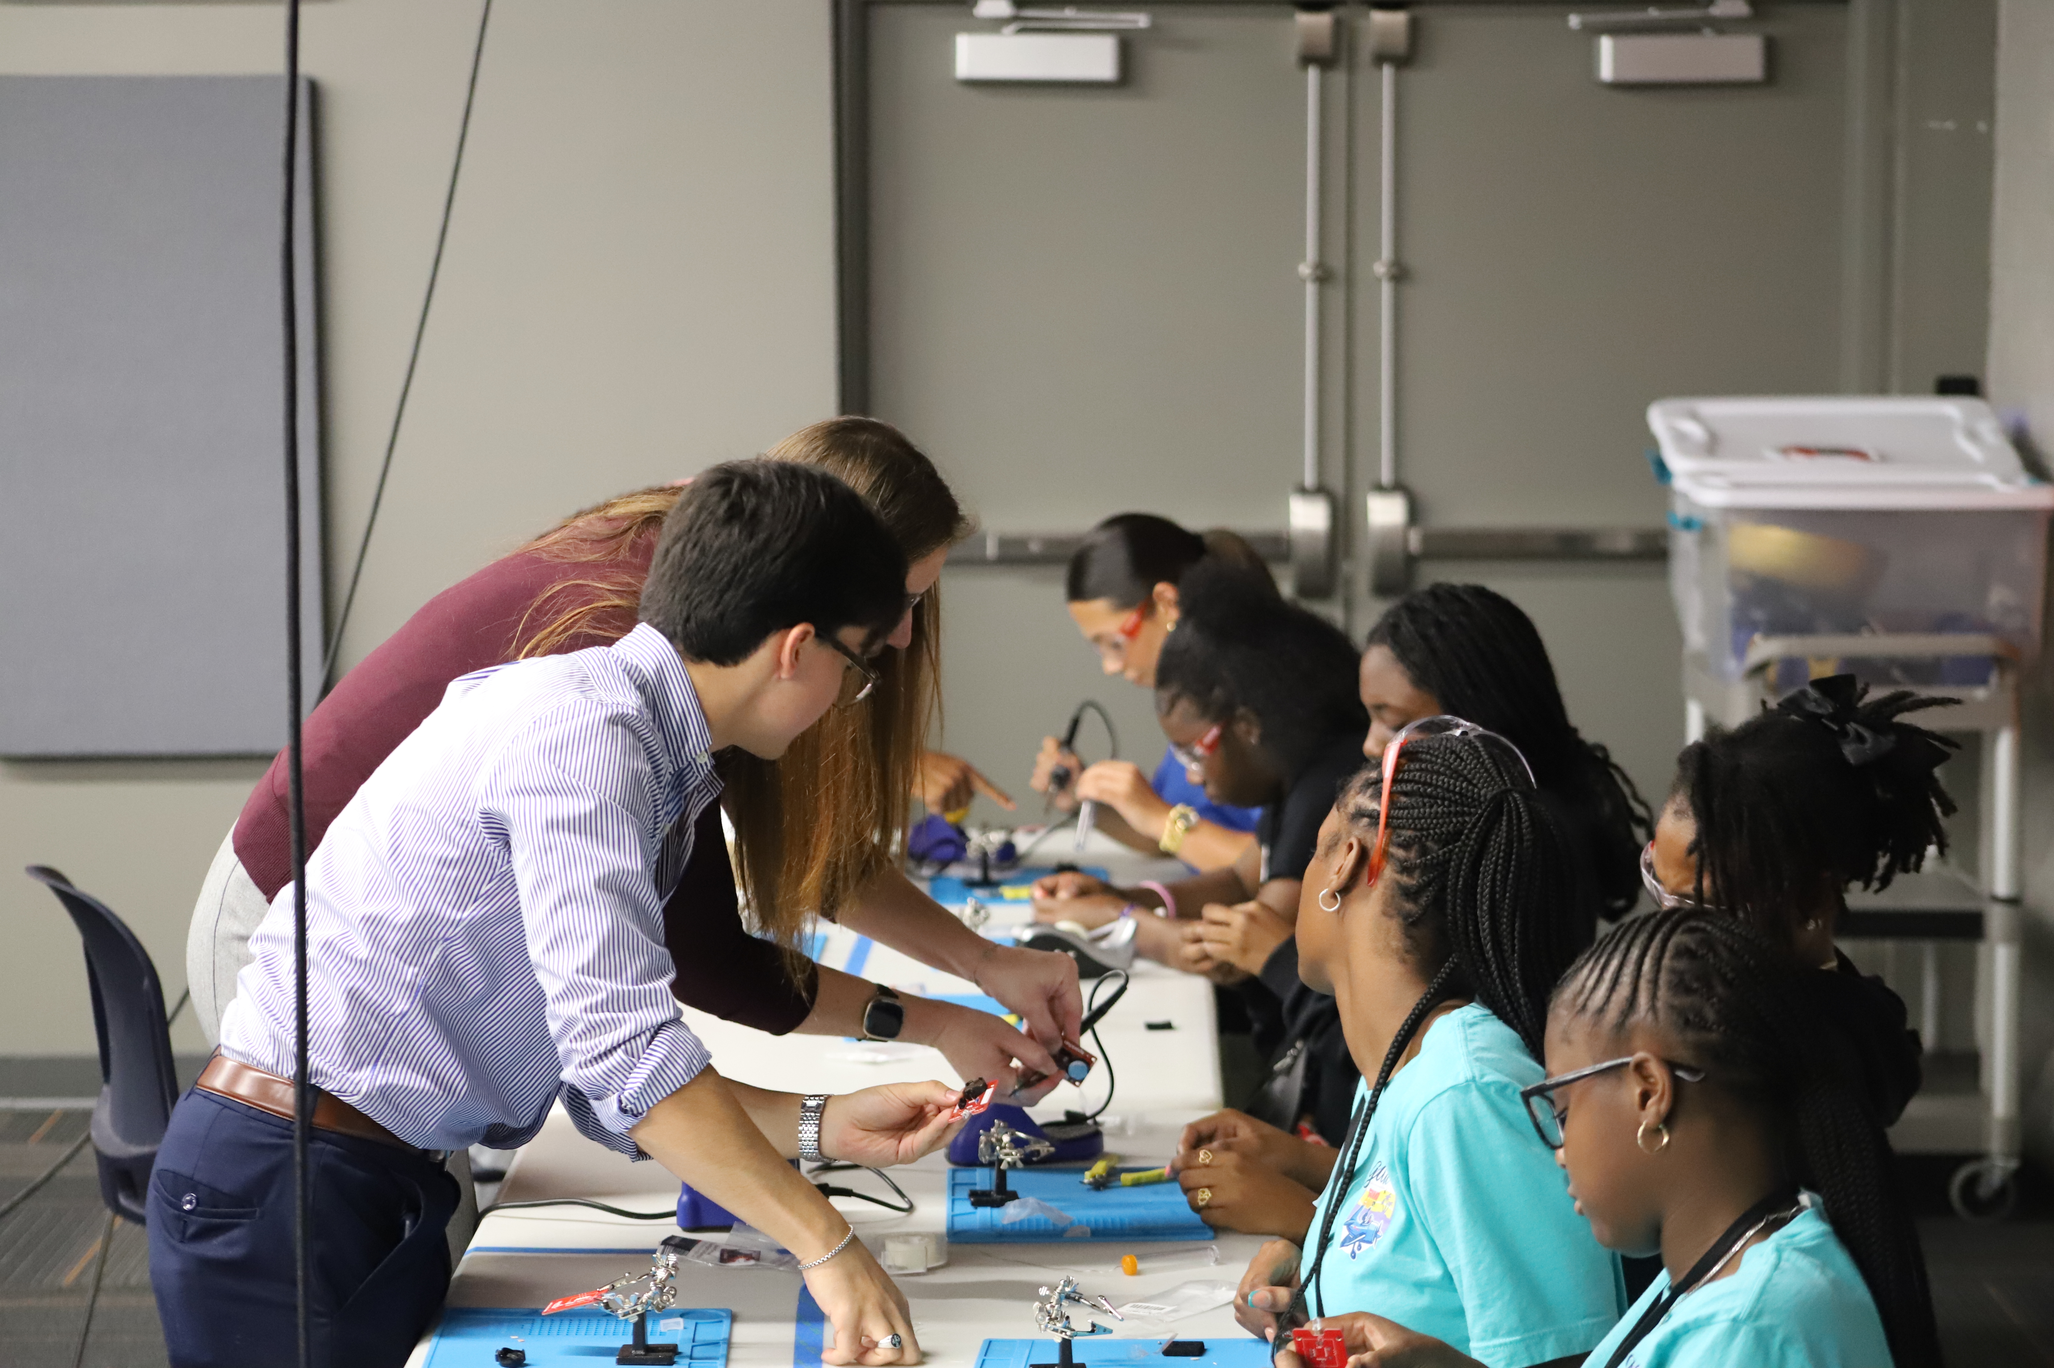
INTERNSHIP &
STEM PROGRAMS
AT SOFWERX
SOFWERX
INTERNSHIP PROGRAM.
Academic/Collegiate Intern support is provided through USF​​
For FY21/22, 43 academic interns from 14 different schools supported SOFWERX efforts​​
Each intern works up to 20 hrs/week during the fall/spring semester and up to 30 hrs/week during the summer semester on approved projects. ​
112 STEM ENGAGEMENTS SERVICING ELEMENTARY/MIDDLE/HIGH SCHOOLS.
Support clubs or kickstart new STEM initiatives​​
Provide education and mentorship to explore career pathways ​​
Create customized activities to demonstrate/showcase innovation processes​.

Slide 10
WHY SOFWERX?
EASY TO ACCESS, REDUCED BARRIERS TO ENTRY
REFINE/INFORM
REQUIREMENTS
NEUTRAL
FACILITATION &
IDEATION
FAIL FAST &
COST OF RISK
AVOIDANCE
FLEXIBLE NON-FAR BUSINESS METHODOLOGIES
AND PROCESSES
FLEXIBILITY THROUGH ADDITIONAL CONTRACTING
MECHANISMS
82% OF OUR SUBMISSIONS COME FROM OUR NON-TRADITIONAL ECOSYSTEM
QUICK WINS
FOR THE
WARFIGHTER

Slide 11
GET INVOLVED WITH
SOFWERX
Join the SOFWERX ecosystem at sofwerx.org/ecosystem.
SMEs can participate in events at events.sofwerx.org.
Innovators are encouraged to submit technologies for events or Tech Tuesday at events.sofwerx.org and sofwerx.org/techtuesday.
USSOCOM can nominate technology focus areas and submit Foundry requests at sofwerx.org/techtuesday and sofwerx.org/foundry.
Bring Warfighter Challenges to sofwerx.org/request.

