Slide 1

US Special Operations Command
UNCLASSIFIED
Win – People - Transform
Information Input for Refinement Decision
X
(U) SOF AT&L, PEO – PM & SOFWERX Collaboration Event
31 March 2026
(U) Purpose: Provide an executive statement regarding the meeting’s purpose
(U) Key Points
(U) ISP Constraints
(U) ISP Pain Points
(U) Outputs
(U) Provide potential vendors an understanding of government program pain points and challenges to seek a commercial solution.
UNCLASSIFIED

Slide 2
UNCLASSIFIED
Opening Remarks
UNCLASSIFIED

Slide 3
Overview
UNCLASSIFIED
(U) The government believes product size and mission duration could be greatly reduced if automated/AI/autonomous solutions could be developed for the following “pain points”.
(U) A methodology and technologies to map buildings and facility sites without existing data. This could be an AutoCAD drawing based on commercial imagery, including autonomous surveying technologies. 2D is required, while 3D capability would be an enhancing feature.
(U) An AI methodology that can take architectural blueprints to reduce the layers of specific structural geometry using AutoCAD or ArcGIS.
(U) Process to quickly photograph interior spaces of buildings.
(U) An Artificial Intelligence (AI) methodology that could recognize, categorize and capture/document building operations, control systems, safety systems, redundant or backup systems, and specific structural aspects of entry and exit of the facility or site.
(U) A methodology and technologies to automate turn by turn directions between two points. Technology must provide video output to cover locations, turns, intermediate critical points, as well as narrative data on area and traffic environments. Technologies of interest include those utilized for autonomous and voice data collection.
UNCLASSIFIED

Slide 4
Constraints
UNCLASSIFIED
(U) All raw data requires extensive data compression.
(U) All collection processes must work without WIFI/BT in a comms degraded environment.
(U) All equipment must be compact and commercial in appearance capable of being brought through an airport.
(U) Collected raw and exported data must be compatible with ArcGIS, ATAK and AutoCAD.
(U) Hardware will be 889 compliant (FAR 52.204-26); UAV compliant with blue and part 107 regulations.
(U) Software must meet USG NIPR/SIPR security accreditation compliance requirements.
(U) Government will have complete access and control of collected & produced data, software code, and processes.
(U) Maintenance and support will be included in the contract.
UNCLASSIFIED

Slide 5
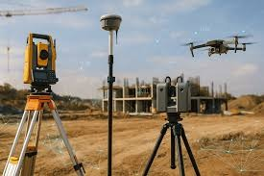
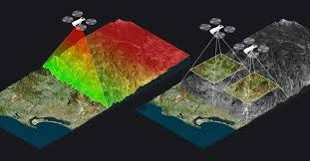
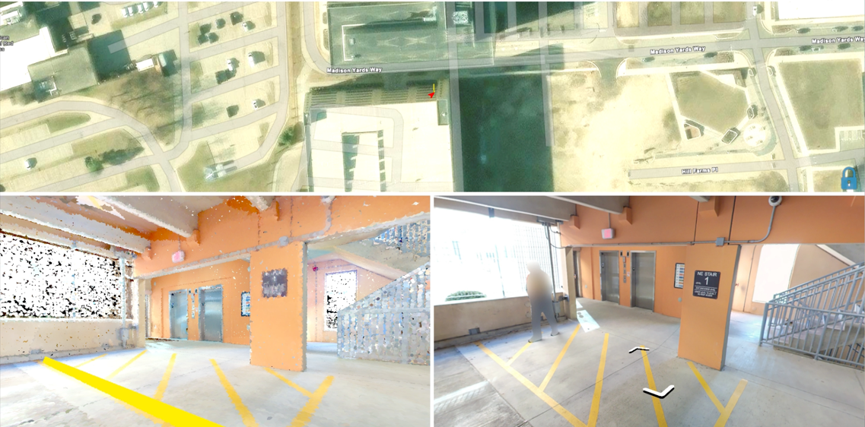
Pain Point #1
UNCLASSIFIED
(U) Methodologies and technologies to map/sketch buildings and sites (indoor & outdoor) without existing data.
(U) Raw and exported data must be in native AutoCAD DWG format.
(U) 2D is required; 3D is an enhancement
(U) Indoor
(U) Automated ability to draw to scale floor plans.
(U) Outdoor
(U) automated drone app for 2D/3D mapping.
(U) extended range flights / reducing interference.
(U) mesh network or antenna to reduce interference.
(U) drones must meet USG Part 107 regulations.
(U) Software/hardware must meet all security and compliance accreditation requirements for NIPR and SIPR.
UNCLASSIFIED

Slide 6
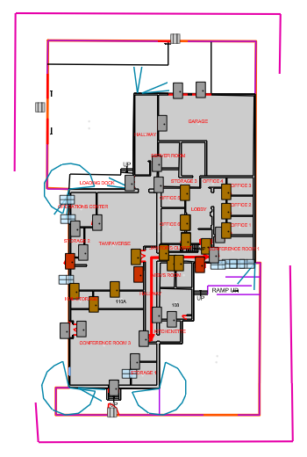
Pain Point #2
UNCLASSIFIED
(U) An AI methodology or AutoCAD tool to modify original Architectural blueprints and reduce layers, contain annotations, structural components, building operations, control systems, safety systems, redundant or backup systems, and specific structural aspects of entry and exit of the facility or site.
(U) 2D is required; 3D is an enhancement
(U) reduction of layers to 5-10 to contain identified data.
(U) data properties must be aligned with government requirements.
UNCLASSIFIED

Slide 7
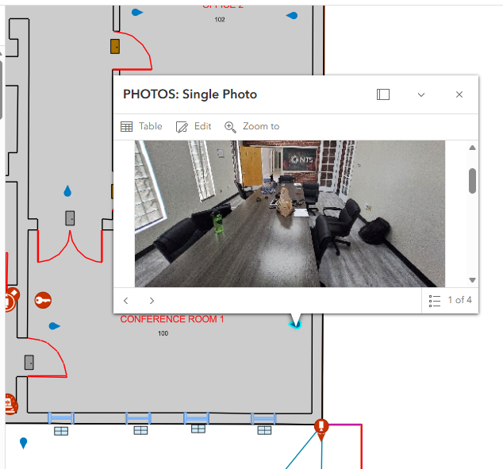
Pain Point #3
UNCLASSIFIED
(U) Process:
(U) Interior and Exterior high-resolution photographs. Every room and space is photograph.
(U) All safety equipment in each room/space must be photographed.
(U) All photos are downloaded to a computer and processed.
(U) Photos are rotated, resized, and renamed.
(U) Photos are dropped into ARCGIS, a description and orientation is manually added to each photo.
(U) A way to quickly photograph the interior of every room in an office building and every space on the exterior.
(U) Eliminate manually entering the photo description.
(U) Create a program/process that will automatically places an icon with photo attached in a CAD drawing. The icon must be geolocated in CAD.
(U) Create a process that will label each photo based on the room name. Every photo in the product must have a unique file name.
(U) Create a process that will maintain the photo as a separate object, when AutoCAD drawing is converted.
(U) Create a process that will identify any safety equipment in the room using the room photo
UNCLASSIFIED

Slide 8
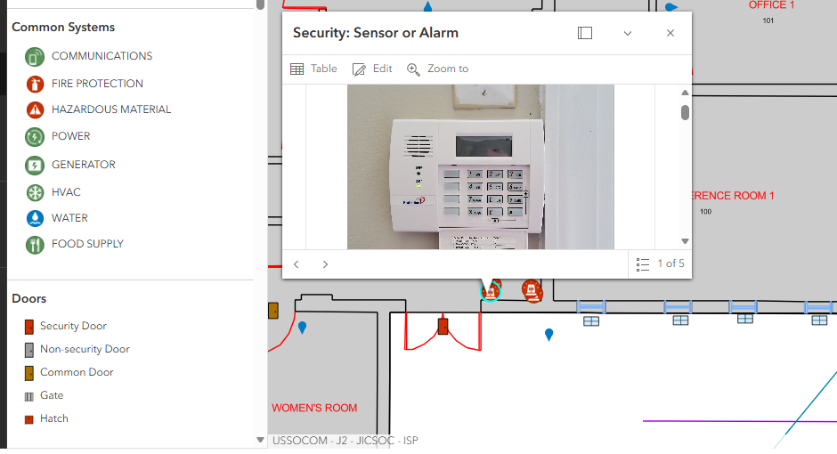
Pain Point #4
UNCLASSIFIED
(U) An Artificial Intelligence (AI) methodology that could recognize, categorize and capture/document building operations, control systems, safety systems, redundant or backup systems, and specific structural aspects of entry and exit
UNCLASSIFIED

Slide 9
Doors/Windows
UNCLASSIFIED
(U) Identify Measurements (Width, Height, Thickness)
(U) Identify all mechanical and functionality aspects.
(U) Identify and populate attribute data from manufacture identification plates.
UNCLASSIFIED

Slide 10
Common Systems & Security
UNCLASSIFIED
Methodology to Identify and place.
Identify and determine all aspect of video camera types and functions (Fixed or Pan-Tilt-Zoom).
Identify and populate equipment type, name, and manufacture data.
UNCLASSIFIED

Slide 11
Pain Point #5
UNCLASSIFIED
(U) A methodology and technologies to automate turn by turn directions between two points. Technology must provide video output to cover locations, turns, intermediate critical points, as well as narrative data on area and traffic environments, road conditions, and usability. Technologies of interest include those utilized for autonomous and voice data collection.
UNCLASSIFIED

Slide 12
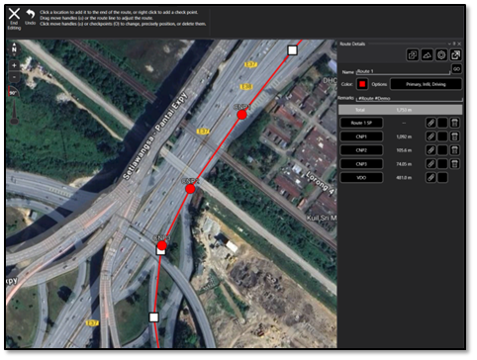
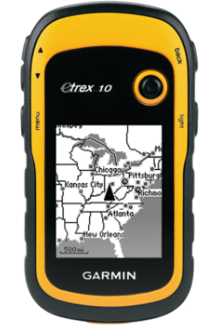
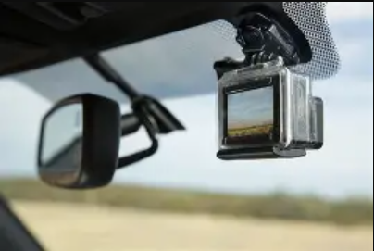
Pain Point #5
UNCLASSIFIED
(U) A technology that can automate turn by turn routes.
(U) A mechanism that provides georeferenced videos of all turns, bridges, overpasses.
(U) An application that copies segments from a georeferenced video and outputs a compressed video below 40 mb of selected segments (ArcGIS Pro compatible)
(U) A mechanism that reports route data including average speed, time traveled, time stopped, and path of route.
(U) A mechanism to provide georeferenced photos of areas of interest along route from video (e.g. fuel stations, service stations, or other user defined categories)
(U) An application that includes ability to trim and/or combine multiple routes
(U) An application which can characterize traffic pattern based on density, road width, condition, road composition, dispersion of road lights, etc. and output short narrative
(U) An application to collect data through voice automation.
UNCLASSIFIED

Slide 13
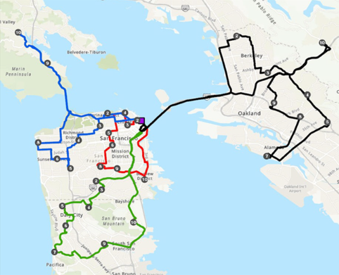
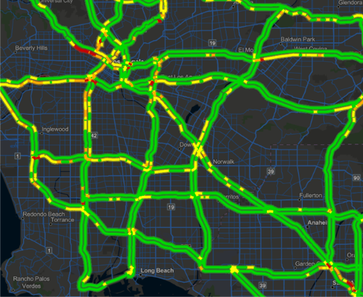
Pain Point #5
UNCLASSIFIED
(U) An application that aggregates open-source data and recommends route based on trafficability variables (Average travel speed, traffic density, construction, number of turns, angle of turn, etc.)
(U) Ability to query open-source traffic cameras along route
(U) Ability to identify user defined areas of interest along route from open source (e.g. fuel points, service stations, etc.)
UNCLASSIFIED

Slide 14
REFERRENCES
UNCLASSIFIED
(U) USG 889
(U) https://www.acquisition.gov/Section-889-Policies
(U) Drone Blue and compliance –
(U) https://bluelist.appsplatformportals.us/
(U) https://www.dhs.gov/science-and-technology/saver/blue-uas-first-responders
(U) https://bluelist.appsplatformportals.us/UAS-Cleared-List/
(U) https://www.ecfr.gov/current/title-14/chapter-I/subchapter-F/part-107
UNCLASSIFIED

Slide 15
Points of Contact
UNCLASSIFIED
(U) SOFWERX:
(U) Name: Claire Harmon
(U) Email: Claire.harmon@sofwerx.org
(U) Phone: 813-825-1374
UNCLASSIFIED

